Slide 1

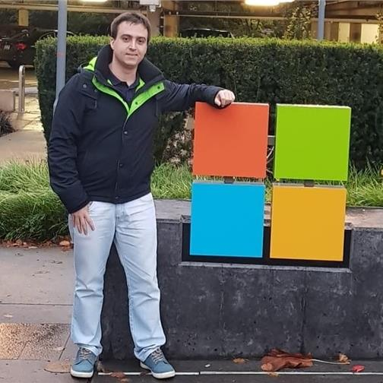
Build Scalable Inventory System with Azure Cosmos DB
Sergiy Smyrnov
Director Specialist, Global Black Belt, Azure Cosmos DB
Speakers
Marcelo Fonseca
Sr Specialist, Global Black Belt, Azure Cosmos DB

Slide 2
AGENDA
1. Real Time Inventory availability system design approach using Event Sourcing
2. DEMO: Real Time Inventory ASYNC pattern
3. DEMO: Real Time Inventory SYNC pattern

Slide 3
Use-Case: Real Time Inventory System
Business
Requirements
Inventory Feed Channels
Presentation UI
Provide accurate “Available to Sell” and “OnHand” quantity in real time
Ability to validate Low Inventory as part of Event processing to avoid processing reservations for Out of Stock
Node Updates
Website/Mobile App Search&Browse
Catalog Updates
Inventory Supply Updates
Cart and Checkout APIs
Customer Reservations
Inventory
Availability
3rd Party API
Demand Fulfillment Updates
System Requirements
Business Ops Updates
Demand/Forecasting APIs
Event Driven
High Write Throughput
High Volume of Data
Elastic Scaling
Fast Reads

Slide 4
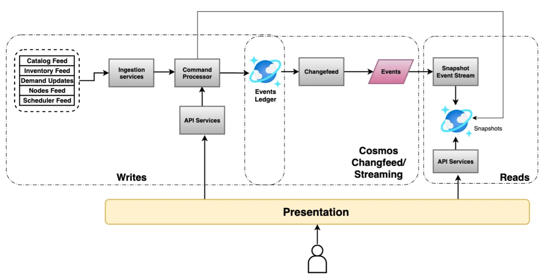
CQRS Event sourcing design
Write Path
Writing Immutable Events into Cosmos DB “Ledger” container – partitioned by “node-SKU” and discriminated by EventType:
InventoryUpdate
OrderCreated
OrderShipped
OrderCancelled/Returned
Command Processor perform any business validations before writing to ledger ( like move order events if there is no inventory to REJECTED queue/container )
Read Path
ChangeFeed processor maintain Materialized Views ( Snapshot Container) via Update/PATCH to calculate ATS, reservations and other values.
1:N multiple MVIEW representations with different partition keys depending on Read Path and Aggregation levels
( default –single Snapshot: same node-SKU)
Read API will always read Snapshot container(s) based on CQRS pattern
Inspired by : https://aka.ms/Walmart-RealTimeInventory

Slide 5

Real Time Inventory - ASYNC pattern
Azure Solution Components
HTAP Reporting/Analytics
Real Time Inventory Event Driven System Design
Azure Cosmos DB
Azure Function
CreateAsyncInventoryEvent
Fabric
Mirroring
Inventory Events Processor
(Low Inventory Business Rule)
Azure Function
inventoryLedger
Inventory
Events Feed
Azure Cosmos DB
Fabric
For Analytics and HTAP reporting
inventorySnapshot
Azure Fabric /Cosmos Mirroring
Azure Function
Inventory Worker
( ChangeFeed)
Inventory Availability READ API
Azure Function
GetAsyncSnapshot
Repo: https://aka.ms/CosmosDB-Inventory

Slide 6
DEMO: Real Time Inventory - ASYNC pattern

Slide 7
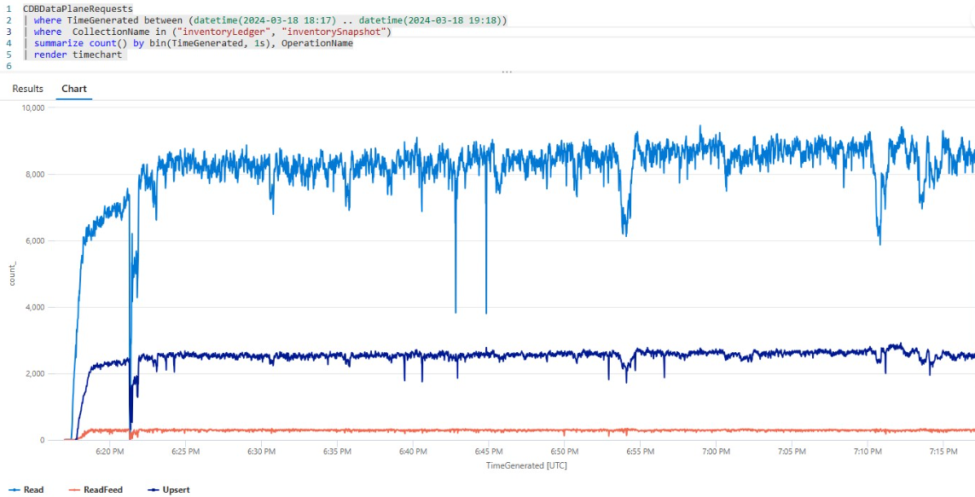
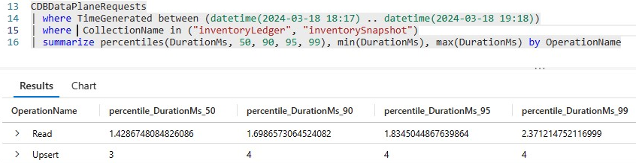
Load Test: Real Time Inventory - ASYNC
Load Pattern:
2,508 writes/sec ( P99-4ms)
8,176 point reads/sec (P99-2.3ms)

Slide 8
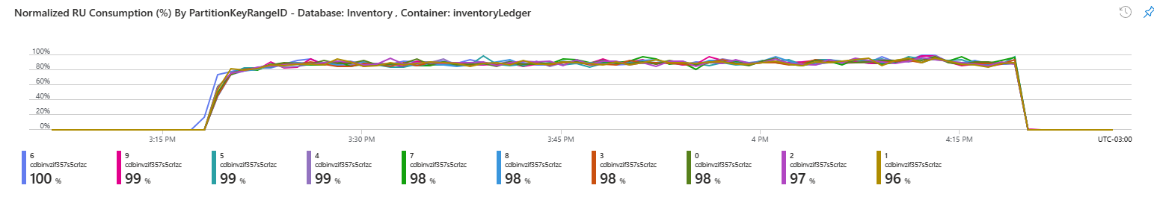
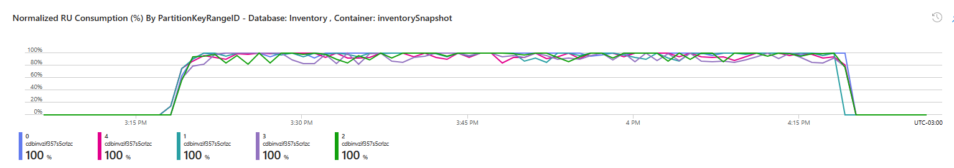
Load Test: Real Time Inventory - ASYNC
Container | RUs (# of physical partitions) | Estimated Cost* – Standard Provisioned
inventoryLedger | 16,000 RUs (10) | $ 934.40
inventorySnapshot | 40,000 RUs (5) | $ 2,336.00
leases | 5,000 RUs (1) | $ 292.00
 |  | $ 3,562.40 / month
* List price - Pricing Calculator | Microsoft Azure ( storage cost is not included , can be estimated at $0.25/Gb)

Slide 9
Real Time Inventory - SYNC pattern
Azure Solution Components
HTAP Reporting/Analytics
Real Time Inventory Event Driven System Design
Azure Cosmos DB
Azure Function
CreateSyncInventoryEvent
Fabric
Mirroring
Inventory Events Processor
(Low Inventory Business Rule)
Azure Function
syncInventory
Inventory
Events Feed
Azure Cosmos DB
Fabric
For Analytics and HTAP reporting
Azure Fabric /Cosmos Mirroring
Inventory Availability READ API
Azure Function
GetSyncSnapshot
Repo: https://aka.ms/CosmosDB-Inventory

Slide 10
DEMO: Real Time Inventory SYNC pattern

Slide 11
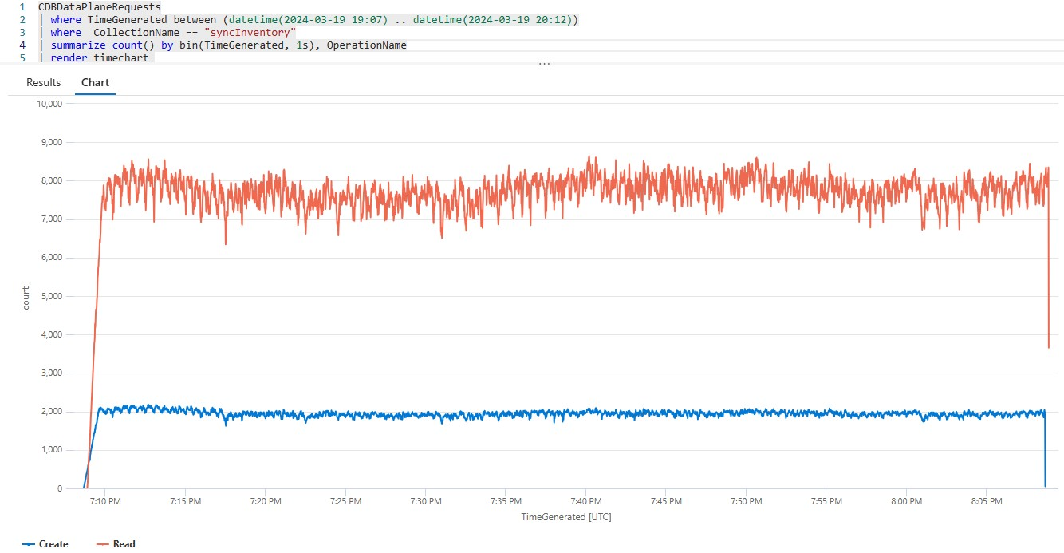
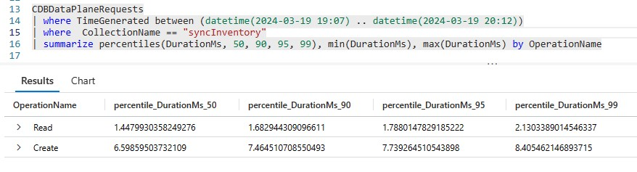
Load Test: Real Time Inventory - SYNC
Load Pattern:
1,931 writes/sec (P99-8.4ms)
7,669 point reads/sec (P99-2.1ms)

Slide 12
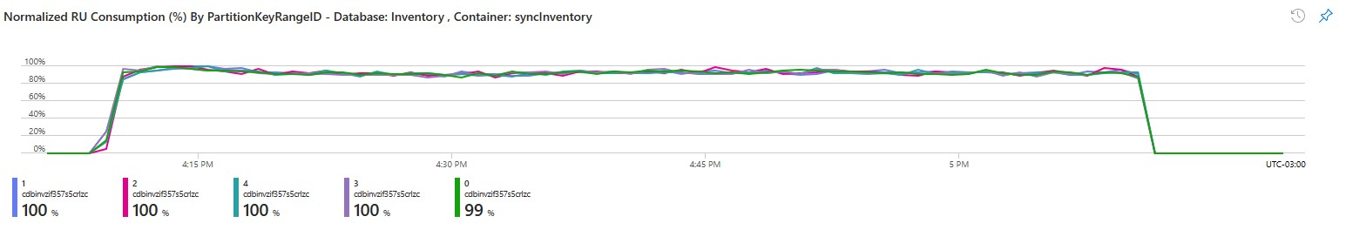
Load Test: Real Time Inventory - SYNC
Container | RUs (# of physical partitions) | Estimated Cost* – Standard Provisioned
syncInventory | 50,000 RUs (5) | $ 2920.00 / month
* List price - Pricing Calculator | Microsoft Azure ( storage cost is not included , can be estimated at $0.25/Gb)

Slide 13
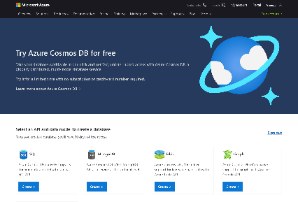
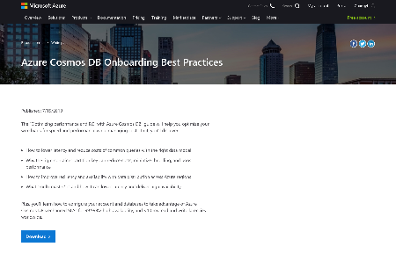
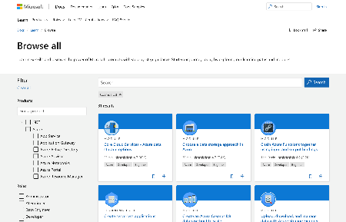
Ready to build modern apps on Azure Cosmos DB? Get started today!
Want to Try it yourself? Clone/Deploy our accelerator repo: https://aka.ms/CosmosDB-Inventory
Try Azure Cosmos DB free
Learn how to use Azure Cosmos DB through tutorials and best practices
Build your skills with Azure Cosmos DB learning modules.
Join Azure Cosmos DB
Cloud Skills Challenge

